Slide 1

MRiLab Simulation Software
Fang Liu, Julia Velikina, Wally Block, Richard Kijowski, Alexey Samsonov
Radiology, University of Wisconsin-Madison, United States
2019 ISMRM Weekend Educational Session:
Open-Source Software Tools for MR Pulse Design, Simulation & Reconstruction
Presenter: Fang Liu, PhD
Notes:
Thanks for the introduction

Slide 2

Declaration of Financial Interests or Relationships
Speaker Name: Fang Liu
UWisc Radiology Receives GE Healthcare equipment support

Slide 3
MRI Simulation
MRI simulation possesses great scientific and educational values for dissimilating MR physics, imaging acquisition and reconstruction algorithms, imaging processing and analysis methods.
Numerical simulation can speed the understanding of existing MR methods and facilitate the development of new MR imaging methods
Flexibility
Functionality
Accuracy Efficiency
Usability
Productivity
Notes:
Increased demand for high efficient and functional MRI simulation software

Slide 4
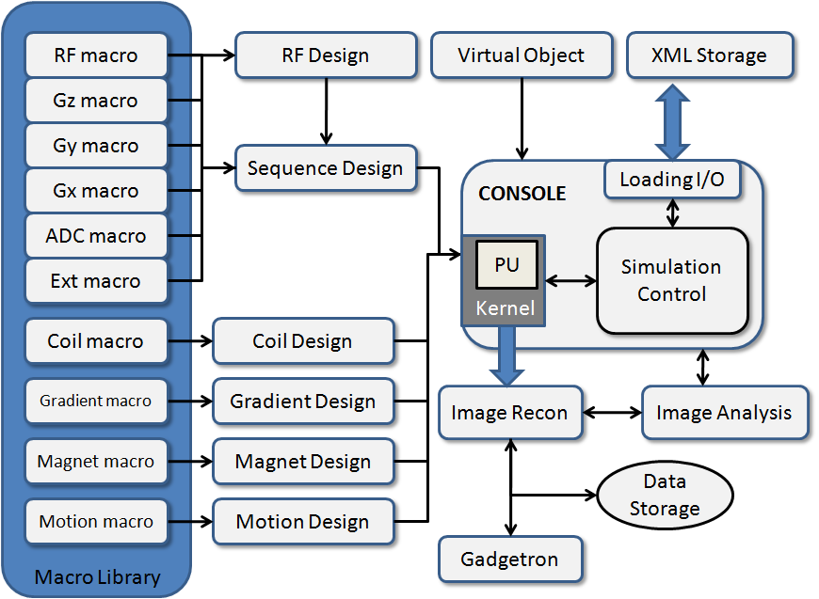
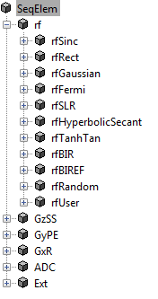
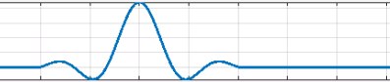
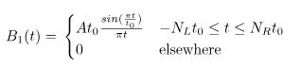
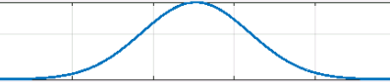
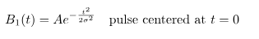
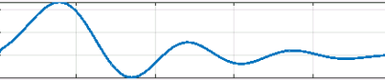
Flexibility and Functionality
Designed with flexibility
A full library of pre-defined macros (function modules) to configure virtual experiment.
Macro controls simulation parameters
RF Macro
Sinc Pulse
Gaussian Pulse
Max phase Shinnar-Le Roux Pulse

Slide 5
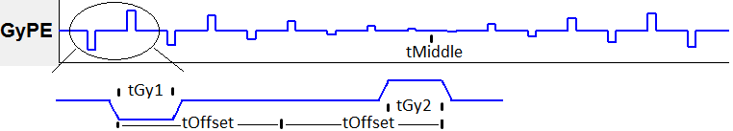
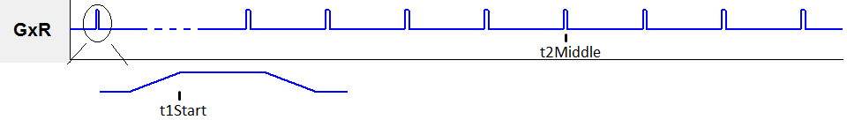
Flexibility and Functionality
Designed with flexibility
A full library of pre-defined macros (function modules) to configure virtual experiment.
Macro controls simulation parameters
RF Macro
Gxyz Macro
ADC Macro

Slide 6
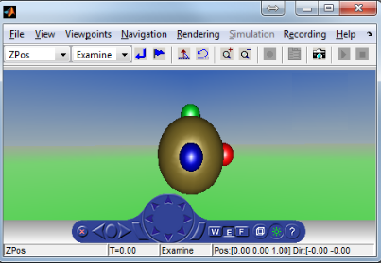
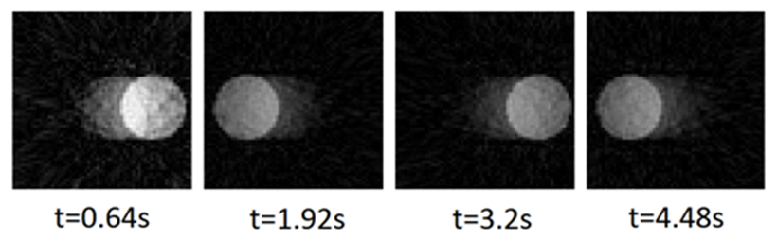
Flexibility and Functionality
Designed with flexibility
A full library of pre-defined macros (function modules) to configure virtual experiment.
Macro controls simulation parameters
RF Macro
Gxyz Macro
ADC Macro
Ext Macro
Extended Simulation Events
1 : Plugin_Timer, calculate remaining scan time
2 : Plugin_IdealSpoiler, dephase transverse magnetization
3 : Plugin_ExecuteMotion, trigger object motion
4 : Plugin_RTRecon, trigger real time image reconstruction
5 : Plugin_ResetK, reset Kx, Ky and Kz to zero
…

Slide 7
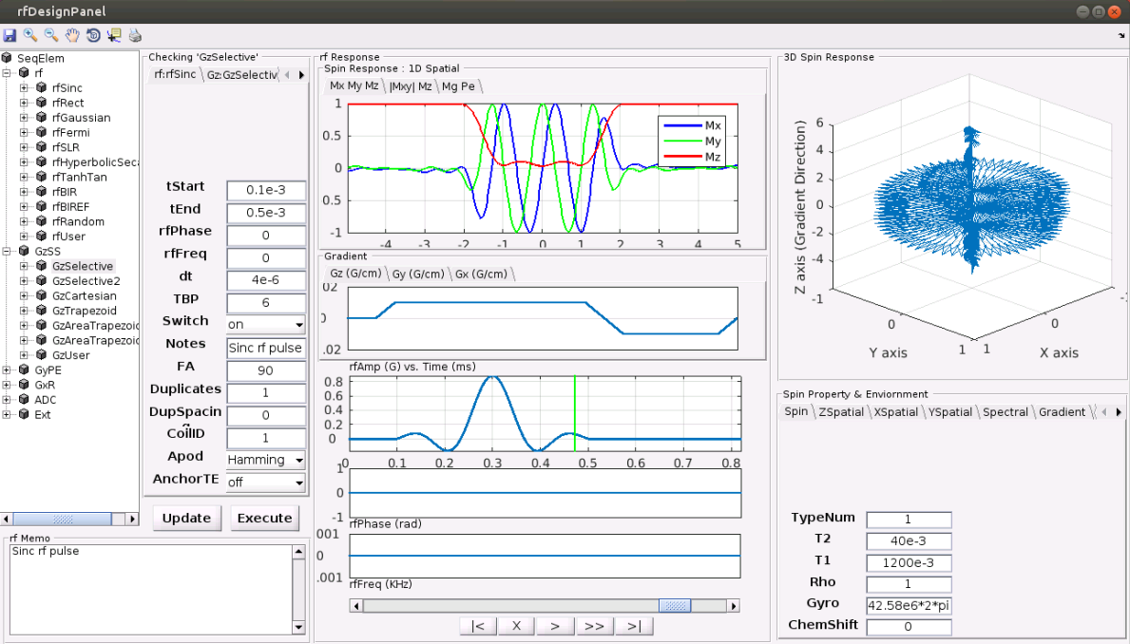
Flexibility and Functionality
Designed with flexibility
Designed for functionality

Slide 8
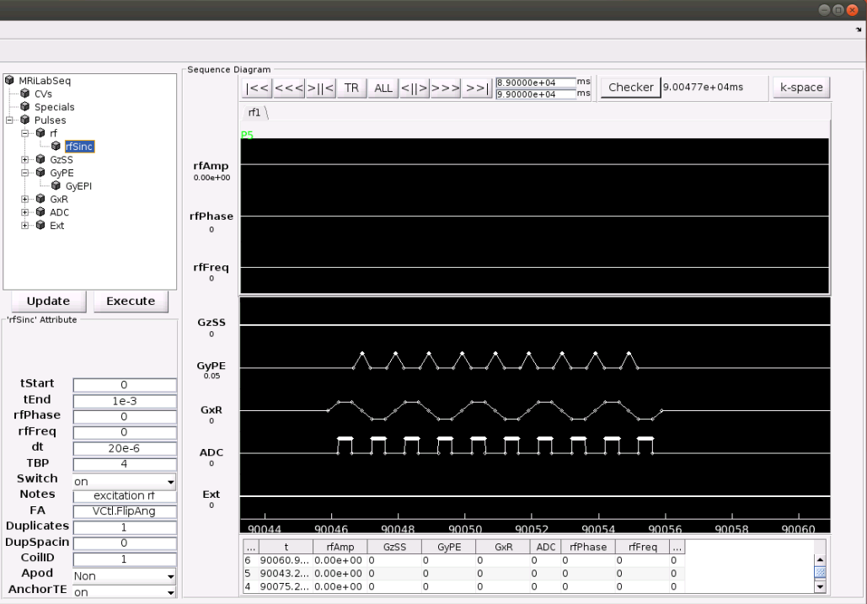
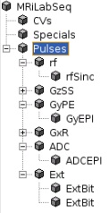
Flexibility and Functionality
Designed with flexibility
Designed for functionality

Slide 9
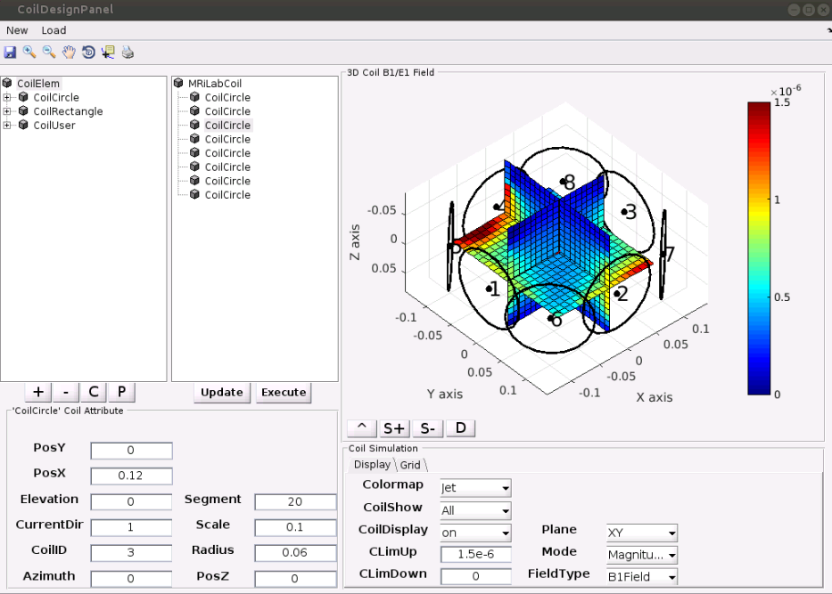
Flexibility and Functionality
Designed with flexibility
Designed for functionality

Slide 10
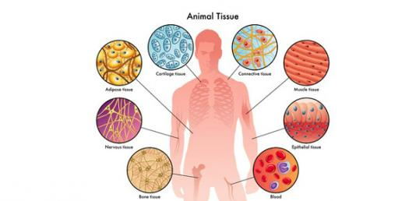
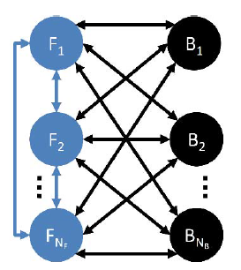

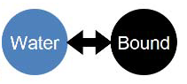
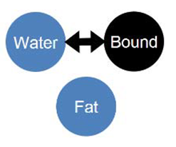
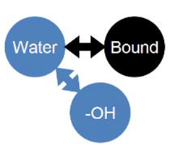
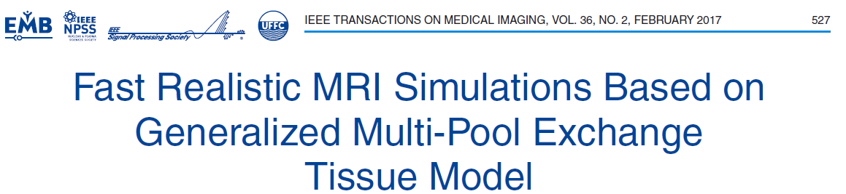
Accuracy and Efficiency
Realistic Tissue Modeling
Generalized multi-pool spin modeling
(Liu et.al. TMI 2016)
Multi-component
Relaxometry
Magnetization
Transfer
Chemical Shift
Imaging
Chemical Exchange
Saturation Transfer

Slide 11
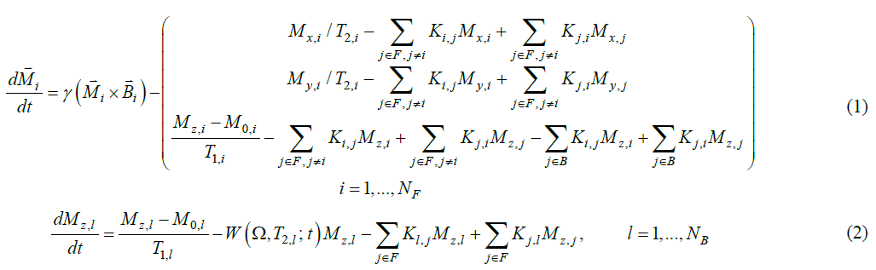
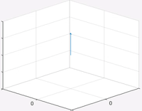
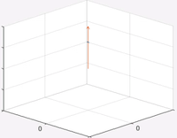
Accuracy and Efficiency
Realistic Tissue Modeling
Generalized multi-pool spin modeling
Finite differential Bloch-McConnel equations in the rotating frame
(Liu et.al. TMI 2016)

Slide 12

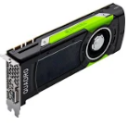
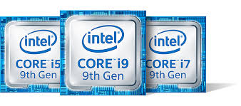

Accuracy and Efficiency
High-performance Computation Engine
Latest parallel computing with GPU acceleration
NVidia CUDA
Multi-core CPU with high-caliber linear algebra computing libraries
Intel IPP, AMD Framewave, OpenMP

Slide 13
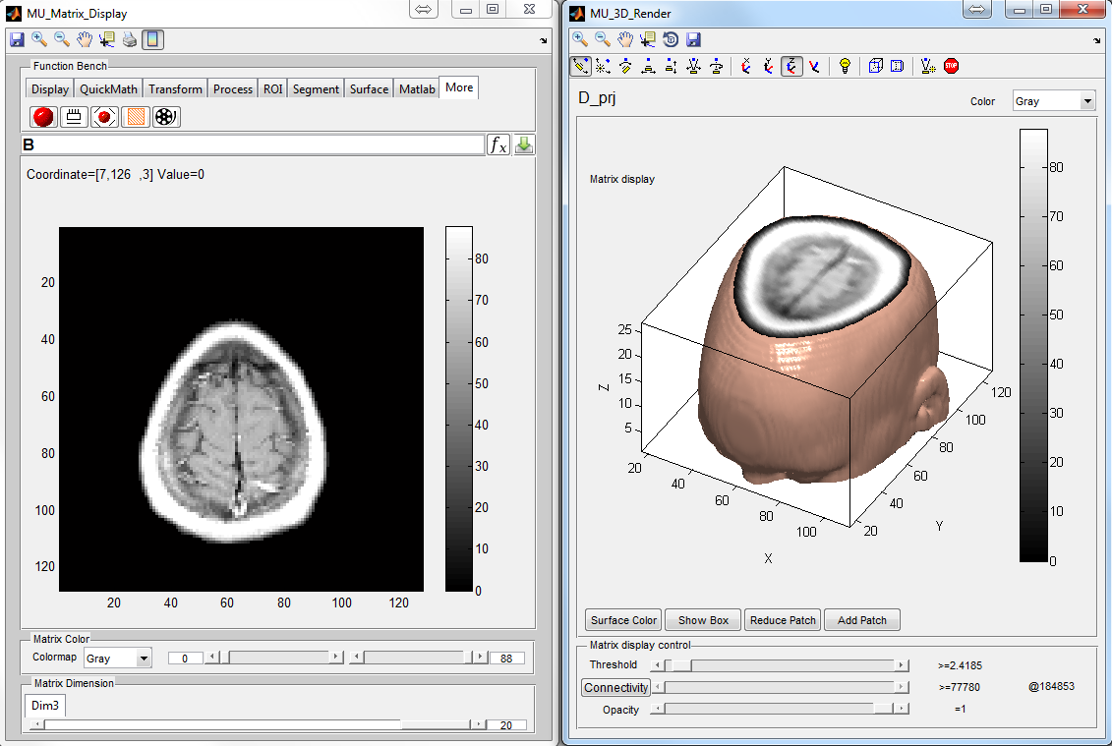
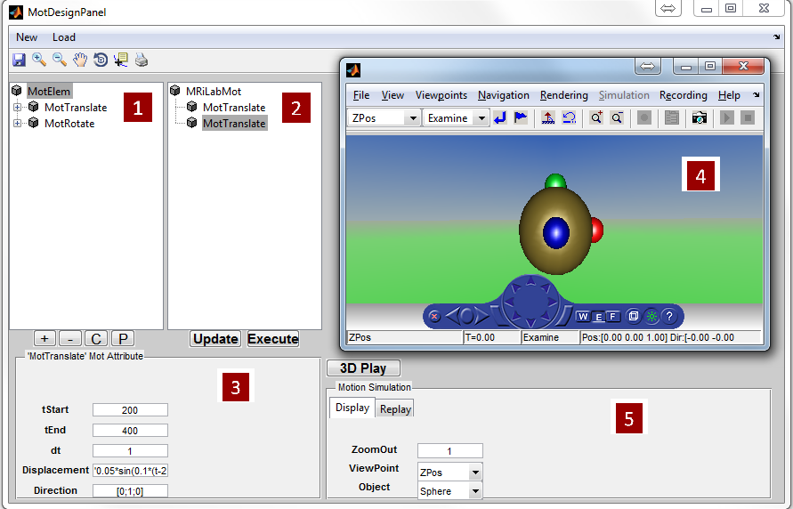
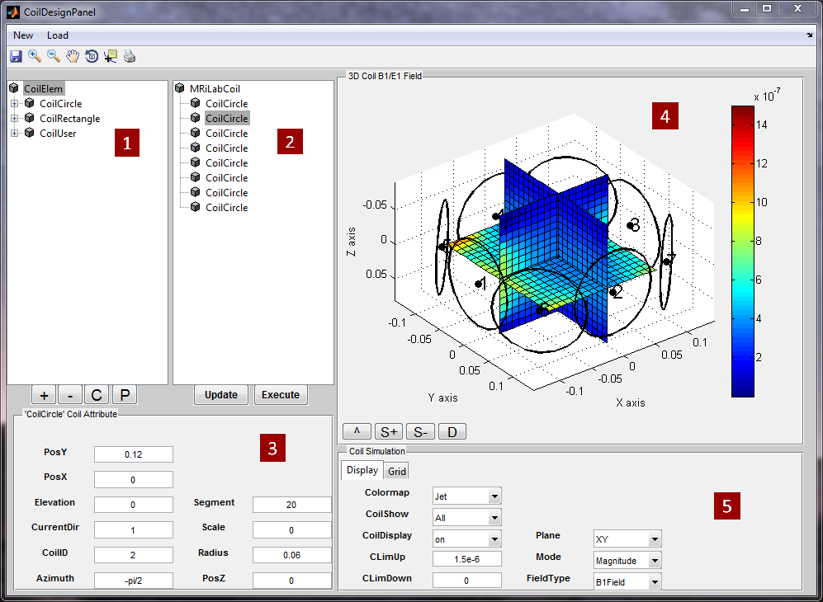
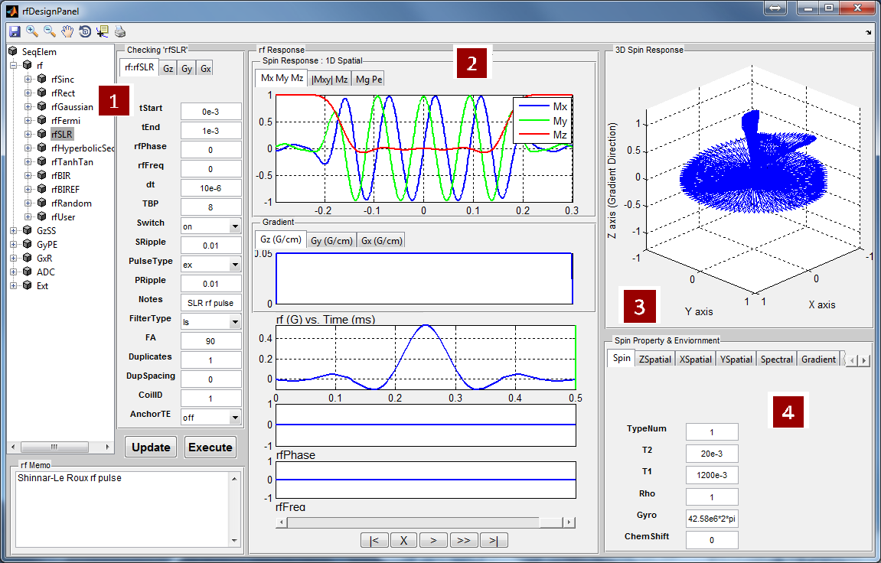
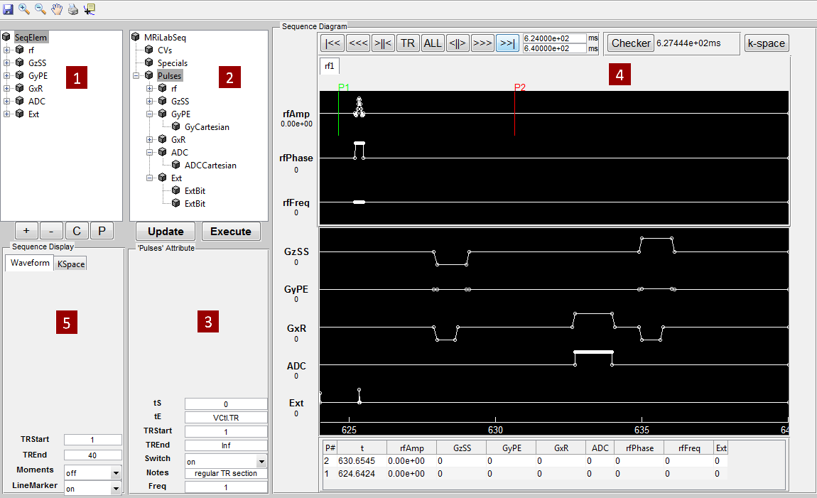
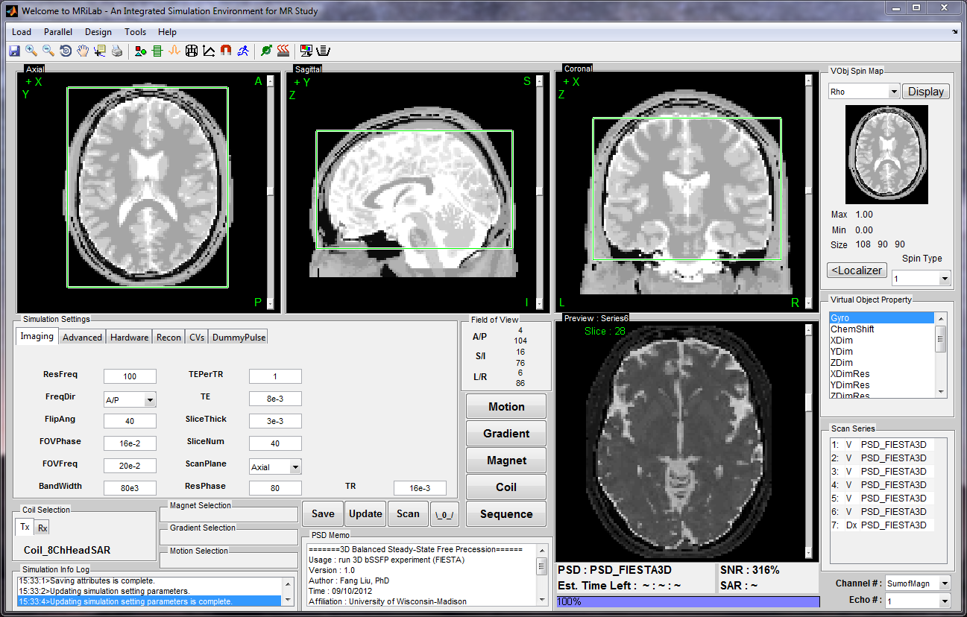
Usability and Productivity
User-friendly Graphical Interface
Enable realistic and interactive simulation environment
Easy access to any function and control
Function Bar

Slide 14

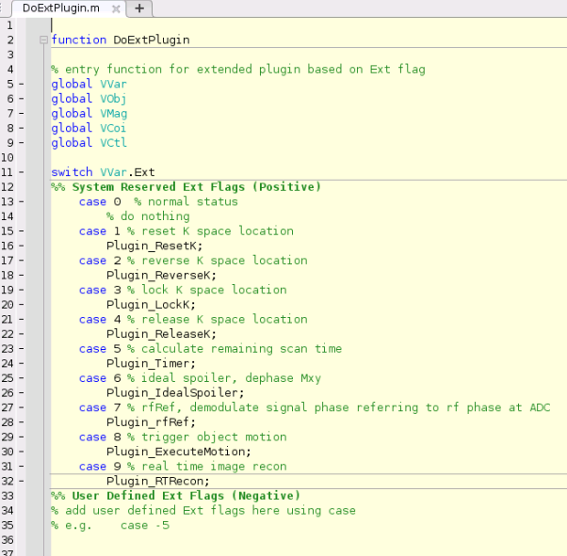

Usability and Productivity
User-friendly Graphical Interface
Enable realistic and interactive simulation environment
Easy access to any function and control
Highly Customizable and Manageable Simulation
Allow user-defined functions
Self-contained Matlab code
Full Open-source

Slide 15
MRiLab: High Performance Simulation to Realistic MR Physics
Frontend Interface
Backend Framework

Slide 16
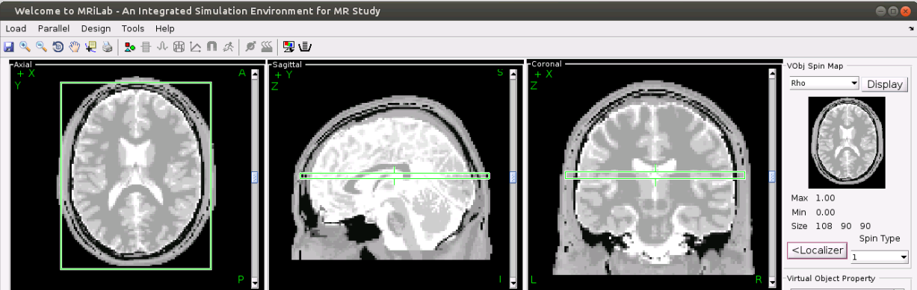
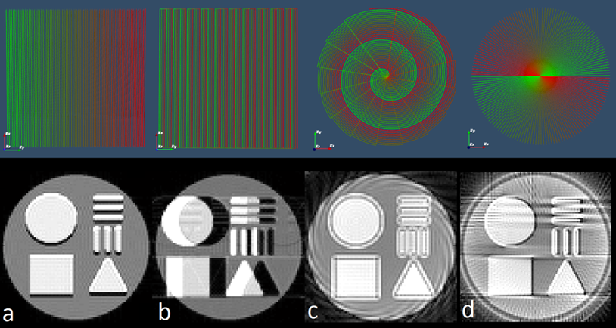
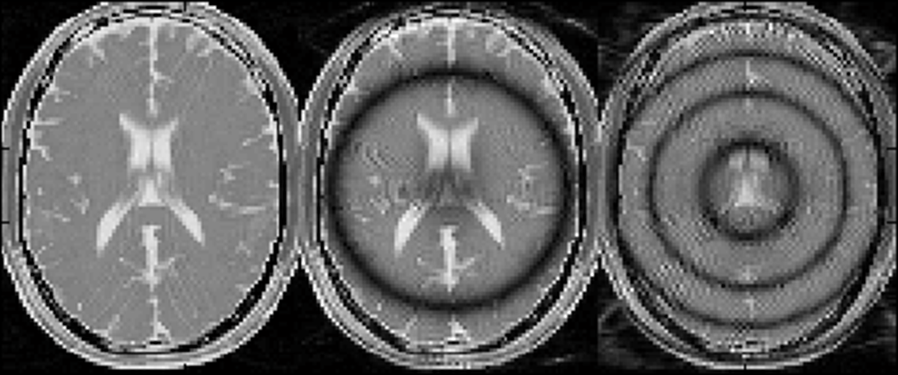
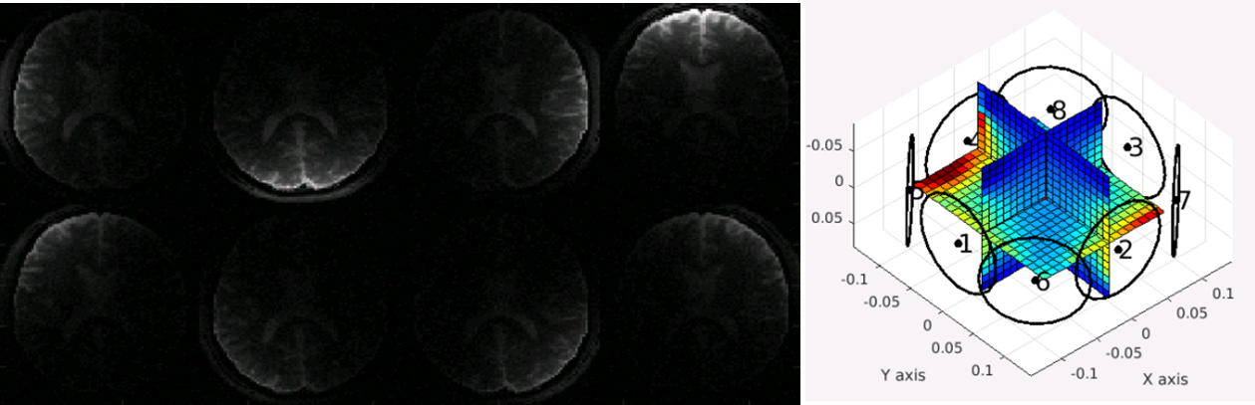
1
What in the Demo
Run and Configure MRiLab
Examples
Simple GRE Simulation
k-Space Acquisition
Steady-state Sequence (bSSFP)
Multi-channel Receiving Coil
2
3
4

Slide 17
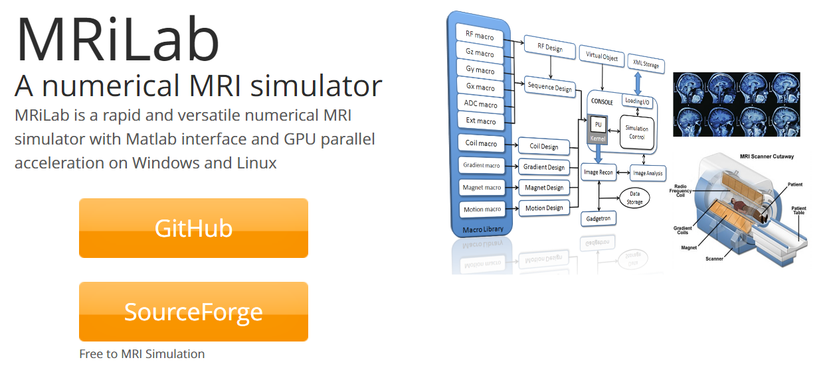
THANK YOU
https://leoliuf.github.io/MRiLab/

